Slide 1
AI RESUME BUILDER
CAPSTONE PROJECT
Presented By:
Afrah Riyas – Arunachala College of Engineering For Women – AI&DS

Slide 2
OUTLINE
Problem Statement
System Development Approach (Technology Used)
Algorithm & Deployment (Step-by-Step Procedure)
Result
Conclusion
Future Scope (Optional)
References

Slide 3
Problem Statement
Creating a professional resume is challenging for students and job seekers who lack experience in content writing, formatting, and identifying relevant skills. Many rely on manual templates which require time, effort, and understanding of resume standards.
Problem:
There is a need for an AI-powered system that can automatically generate well-structured, ATS-friendly resumes, improve content quality, and assist users with skill recommendations based on the job role they want.

Slide 4
System Approach
Frontend | Streamlit-based interface for user input (personal details, skills, projects), template preview, and resume download
Backend | Python backend to process user data, call AI APIs, generate content, perform skill-matching, and assemble final resume.
Model Engine | OpenAI / Google AI Studio model for text generation (resume bullets, summary, skill suggestions)
Data Handling | Handles user inputs temporarily during session; allows optional job description upload; supports exporting formatted resume (PDF/DOCX)

Slide 5
Algorithm & Deployment
1. Data Input
User enters basic details: Name, Education, Skills, Projects, Experience.
Optional: User uploads a Job Description for AI matching.
2. Resume Content Generation
AI model analyzes inputs.
Generates improved bullet points for Experience, Projects, and Skills.
Ensures ATS-friendly keyword optimization.
3. Skill Matching (New Feature)
AI compares resume content with the Job Description.
Highlights missing skills and suggests improvements.
4. Template Auto – Selection (New Feature)
System selects a professional template based on profile type:
Student/Fresher
Entry-Level
Experienced
5. Deployment
Frontend built using Streamlit.
Backend integrated with Google AI Studio / OpenAI API.
Hosted on Streamlit Cloud or GitHub Pages.

Slide 6
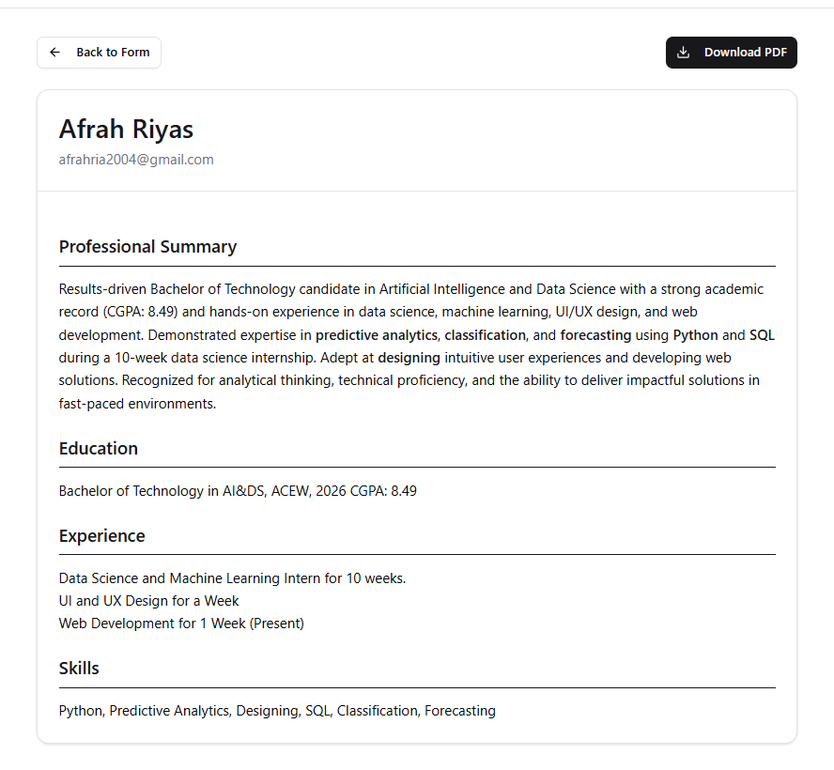
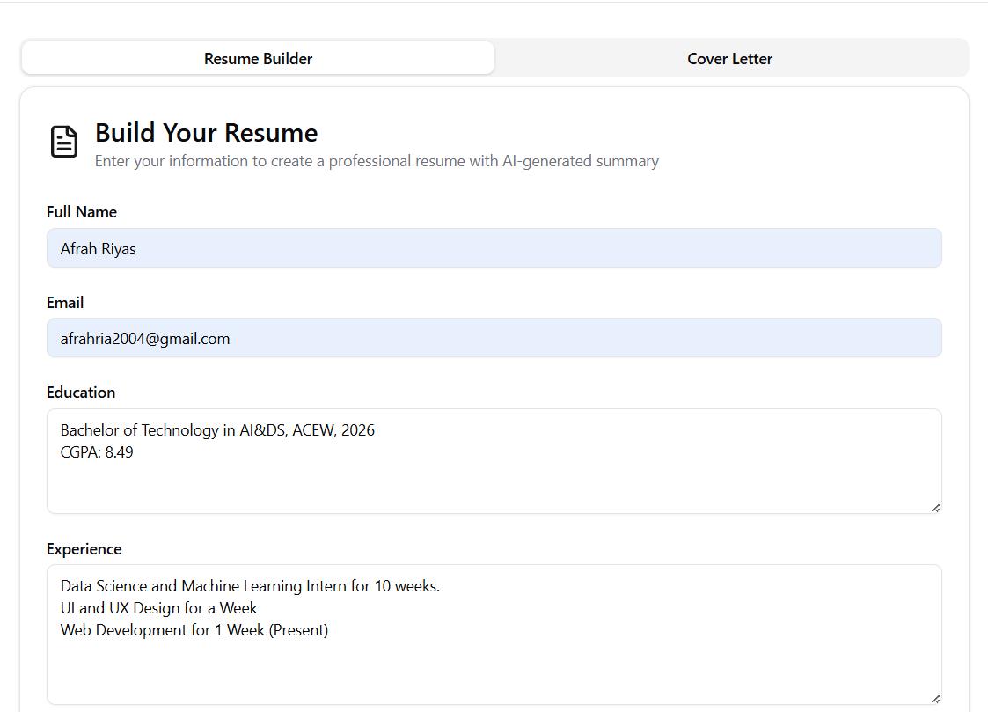
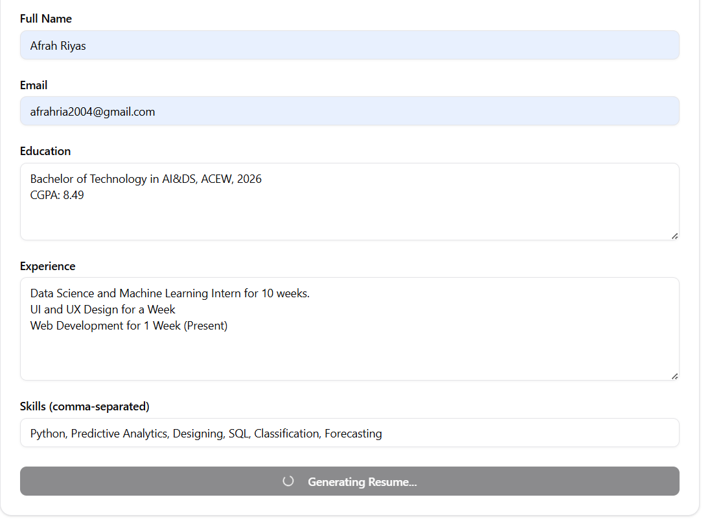
Result

Slide 7
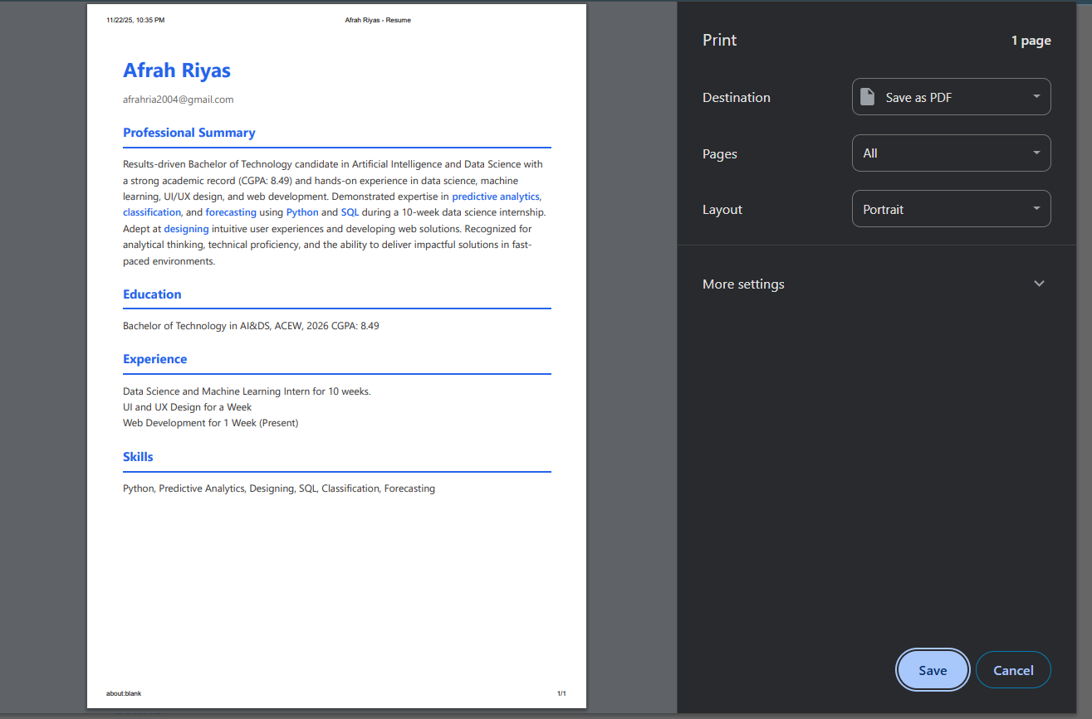
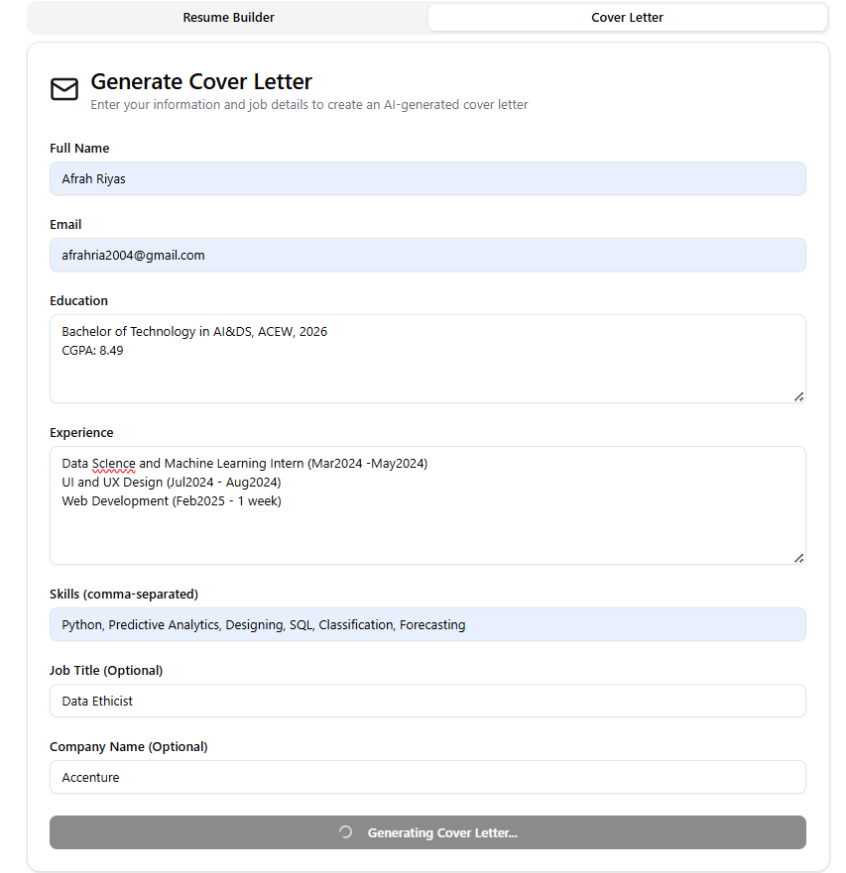
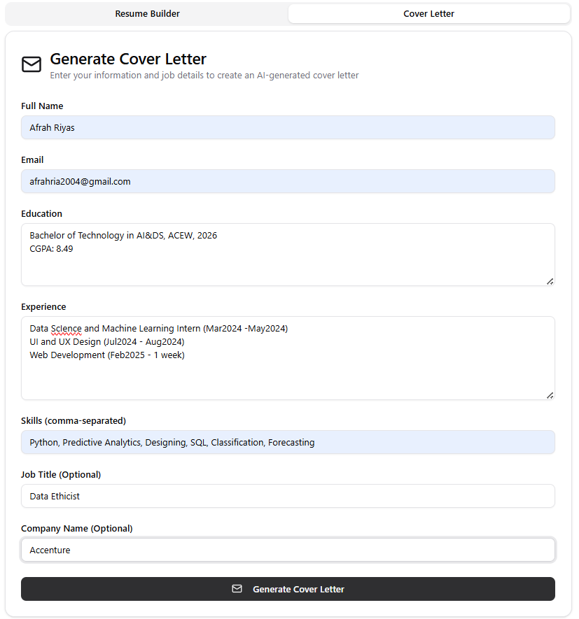

Slide 8
GITHUB AND DEPLOYMNET LINK
Attach your Github Link : coding files GITHUB https://github.com/Afrah-Riyas-1154/AI-RESUME-BUILDER.git
Deployment link: GITHUB/SOME OTHER PLATFORM
https://production.creao.ai/share?app=1OjyoLT8&utm_source=share&utm_medium=link

Slide 9
Conclusion
The AI Resume Builder automates resume creation by generating high-quality, professionally formatted content. With features like skill-matching and smart template selection, the system helps users produce stronger, industry-aligned resumes in minutes. It significantly reduces human effort and ensures better job-readiness.

Slide 10
Future scope(Optional)
Add LinkedIn profile analysis for personalized suggestions.
Generate cover letters automatically.
Provide multiple export formats (PDF, DOCX).
Add multilingual resume generation.
Job-role–based resume rewriting (Software Engineer, Data Analyst, etc.).

Slide 11
References
OpenAI API Documentation – Guidelines and examples for integrating GPT-based text generation models into Python applications.
Google AI Studio Documentation – Reference material for prompt design and cloud-based AI model usage.
Streamlit Official Docs – Used for building the resume builder frontend interface and deployment steps.
Hugging Face NLP Resources – General guidance on text generation, summarization, and keyword extraction.
Resume Writing Standards (Naukri, Indeed, LinkedIn) – Used to understand modern resume structure, ATS rules, skill section formatting, and professional bullet point writing patterns.
IEEE & ACM Articles on AI Content Generation – Background research on reliability, ethical usage, and text-generation best practices.
W3C HTML/CSS Guidelines – For creating standardized and clean resume templates.

Slide 12
THANK YOU

